Slide 1
Food Guides Around the World

Slide 2
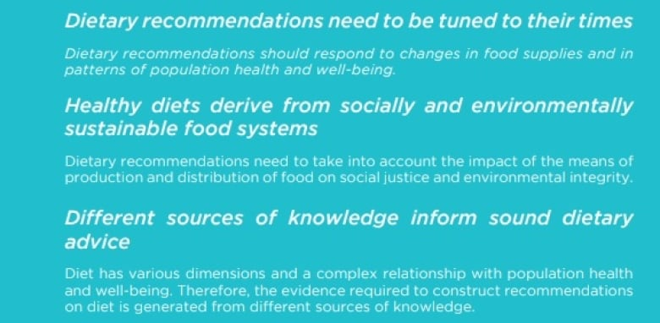
Brazil

Slide 3
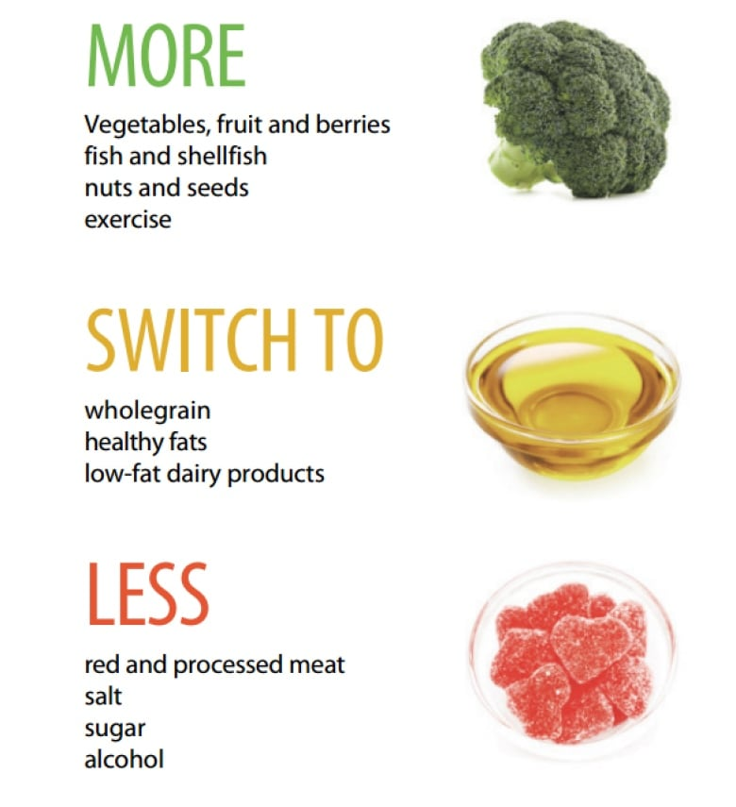
Sweden

Slide 4
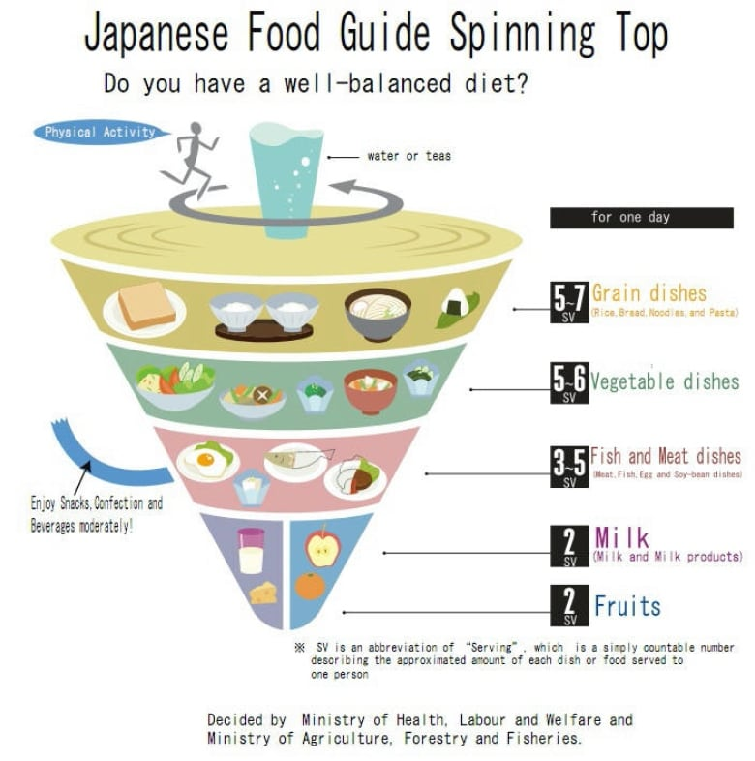
Japan

Slide 5
France

Slide 6
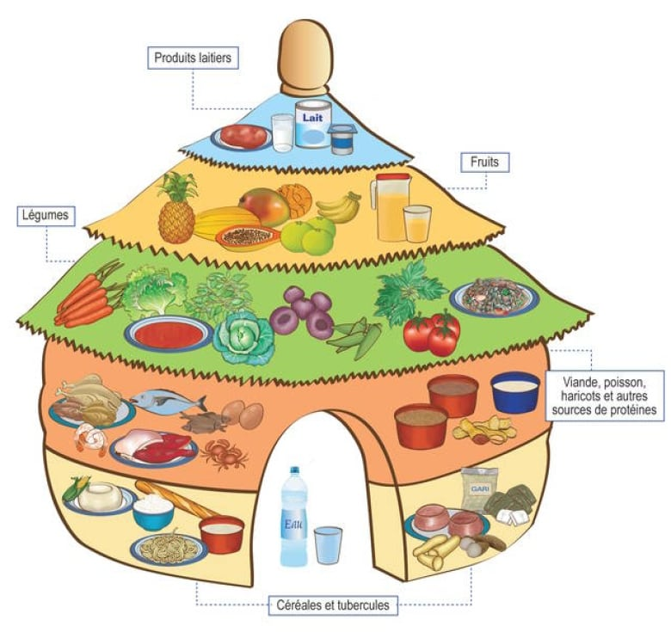
Benin

Slide 7
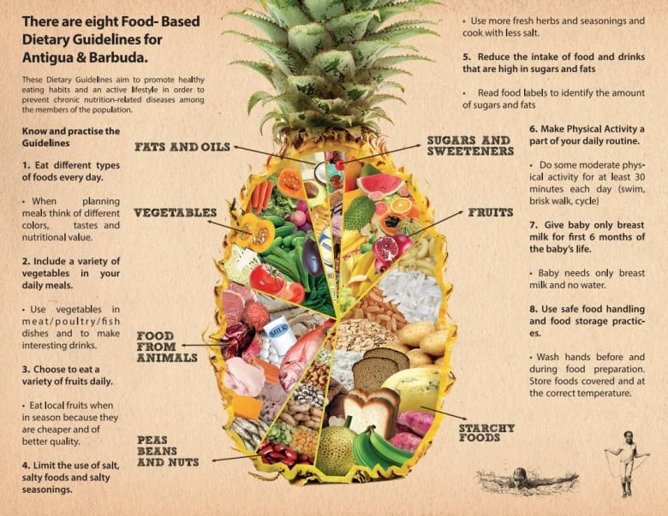
Antigua
& Barbuda

Slide 8
Qatar

Slide 9
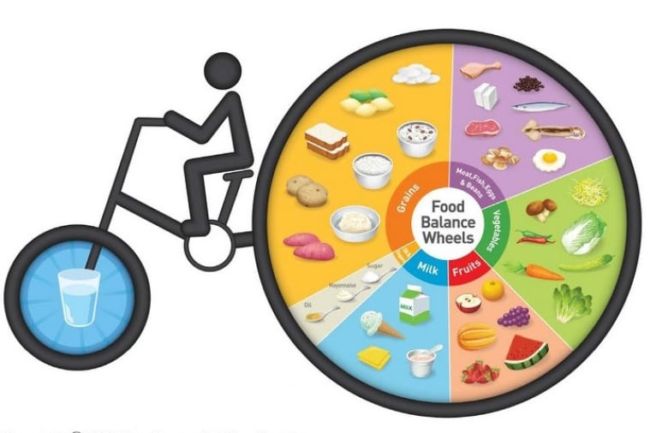
Korea

Slide 10
Compare and Contrast
Name at least three common themes from the collection guides. Name three things that you noticed were unique to some/one.
Which food guides were the easiest to understand? Which were the most difficult? Which one do you vibe with the most? Explain why.
What connections can you make about the local culture and the food guide recommendations?
Which guide is most like the one you follow in your own diet.
If all food guides are different, is there a right/wrong way to eat? Explain your thoughts.

Slide 11
Canada Food Guide Assignment

Slide 12
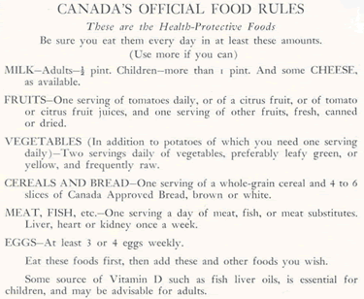
1942

Slide 13
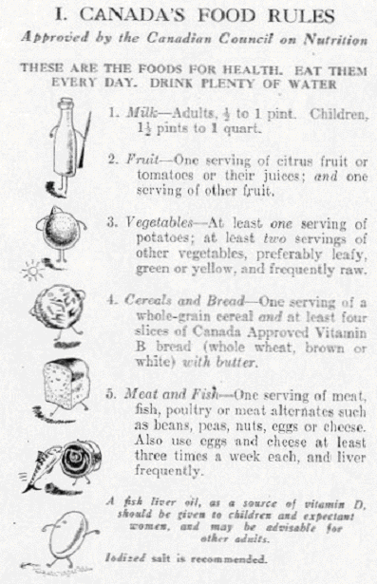
1944

Slide 14
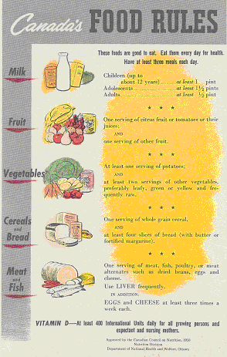
1949

Slide 15
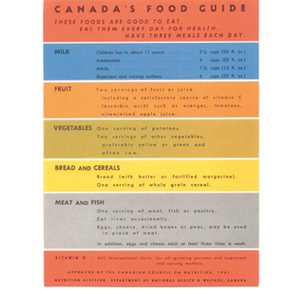
1961

Slide 16
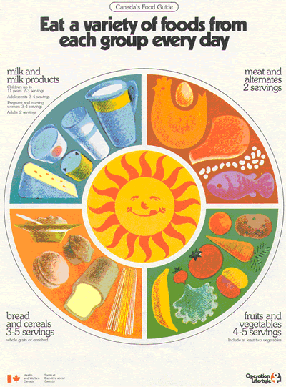
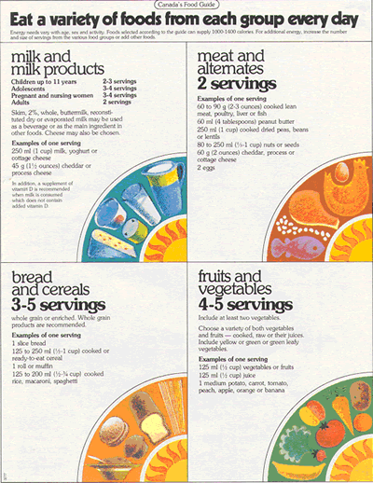
1977

Slide 17
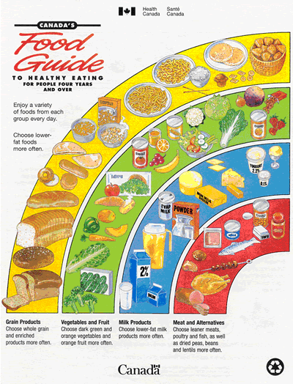
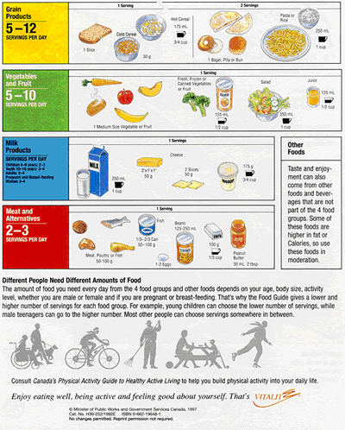
1992

Slide 18
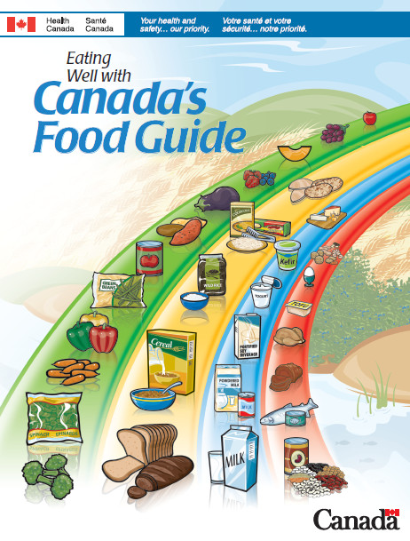
2007

Slide 19
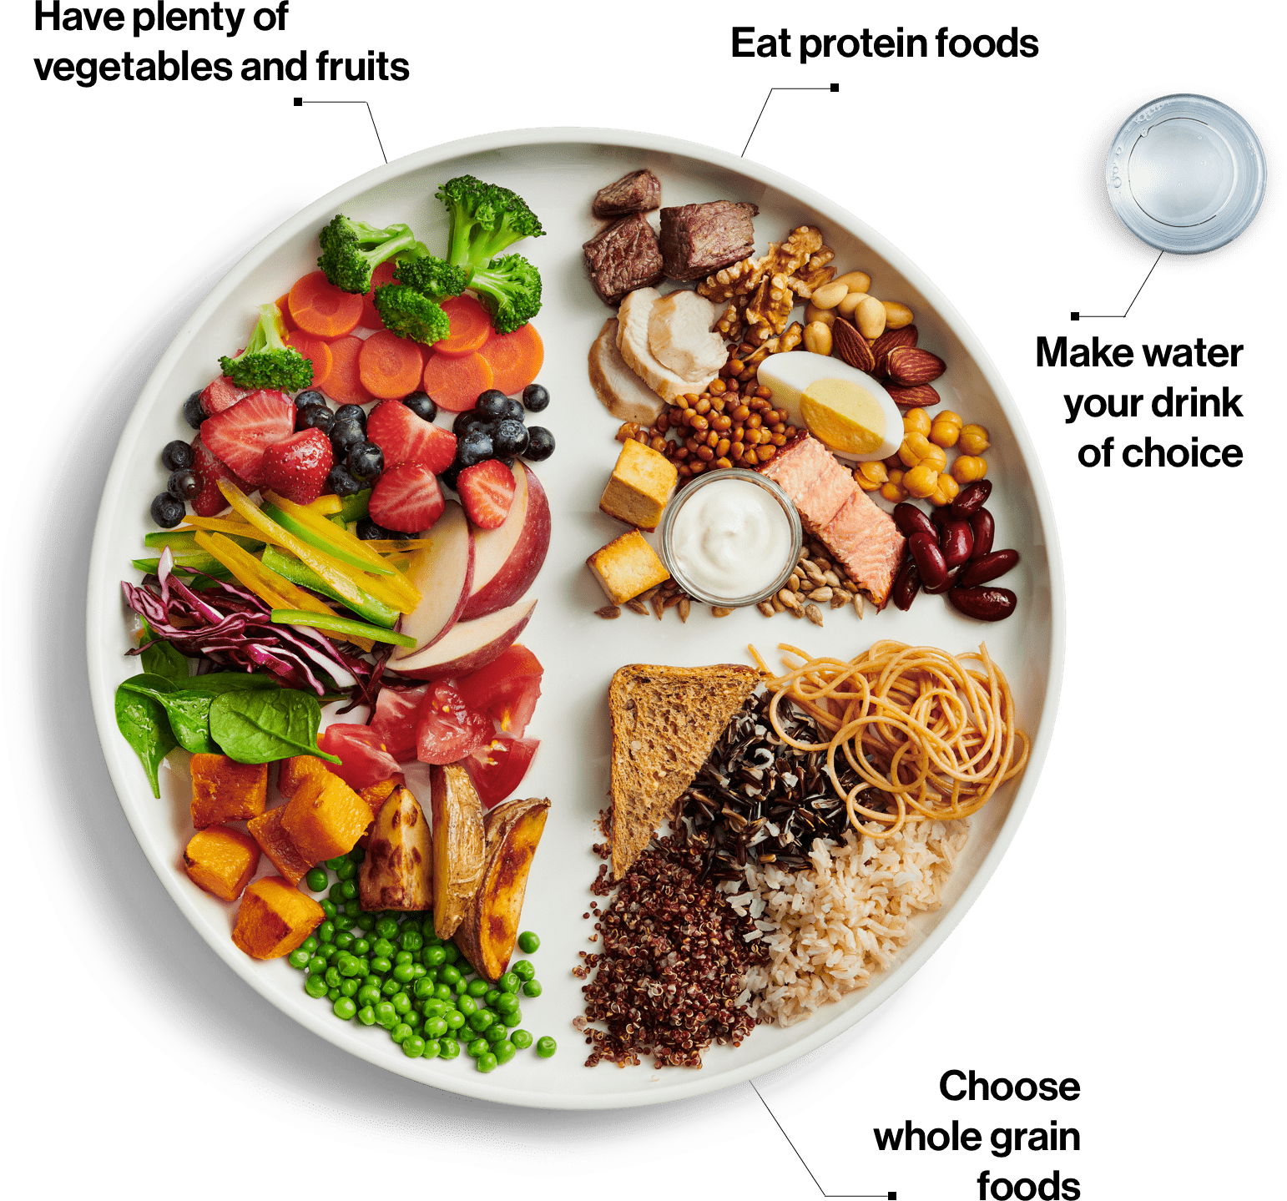
2020

Slide 20
Questions
Compare and contrast the Canadian Food Guides.
Which one do you feel like is the easiest to understand?
How have the Guides changed over time? Have the dominant food groups stayed the same?
What was the food guide that your parents grew up with? Does it shape their cooking or dietary habits?
Do you feel like your diet follows the latest guide?
What are some things you would like to change in your diet that are within your control?

